Slide 1
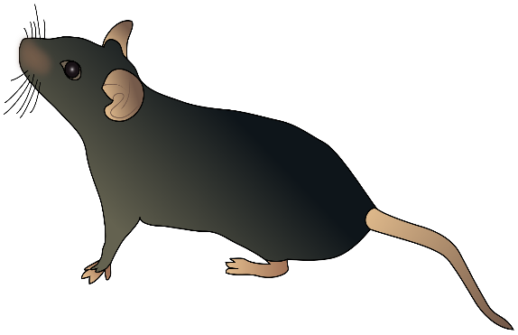
Exercise in mitochondrial mutant mice – friend or foe?
20m/min
Progress report
Patrick Schaefer
5/18/20

Slide 2
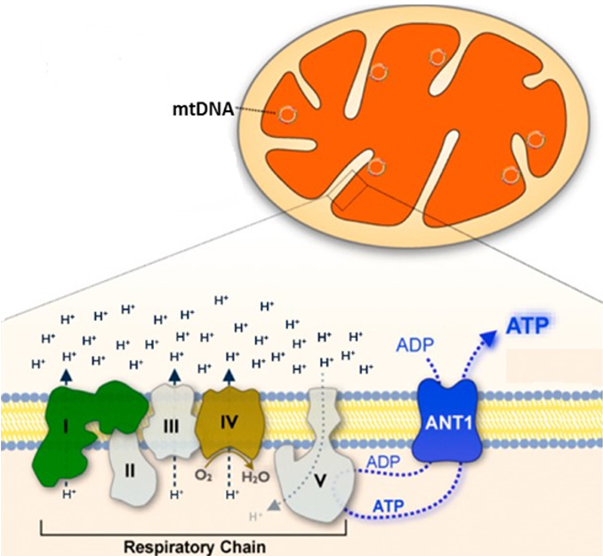





Mitochondrial mutant mouse models
ND5 ME
ANT1 ME
B6 ME
IAI ME
EC77 ME
Hypothesis: Mitochondrial genotypes modify exercise physiology and exercise response

Slide 3
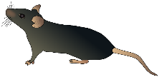
Exercise in Mouse Models for Mitochondrial Diseases
1) Exercise physiology in mitochondrial mutant mice
How do different mitochondrial mutations affect basic and exercise physiology
Which factors limit the exercise capacity in mitochondrial mutant mice
2) Exercise response to endurance exercise in mitochondrial mutant mice
16 weeks
2 days
2 days
8 weeks
2 days
2 days
CLAMS
VO2max
start
training
CLAMS
Echocardiography
Collect tissues
Respiration+ROS
VO2max
48h
48h
50% of max. stage
45min
Every 2nd day

Slide 4
All mitochondrial mutant strains display lower activity levels but similar oxygen consumption
**
***
***
*
***
*
*
16 weeks, male, n=24-40

Slide 5
ANT1 ME display lower exercise capacity
VO2max
VO2 norm. to rest
***
***
**
**
***
***
***
***
**
*
***
***
*
***
**
Running time
RER max
***
***
**
***
***
*
***
16 weeks, male, n=24-40

Slide 6
VO2 in ANT1 ME decreases upon running
16 weeks, male, n=24-40

Slide 7
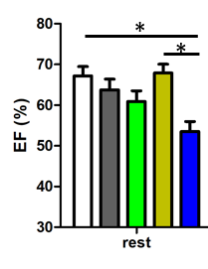
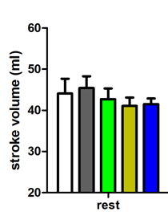
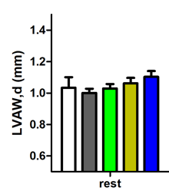
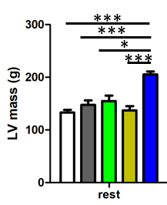
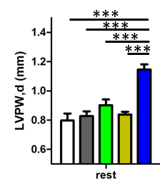
Limiting factors for VO2
O2 delivery - heart
Cardiac output upon exercise?
***
***
***
***
24 weeks, male, n=12-15

Slide 8
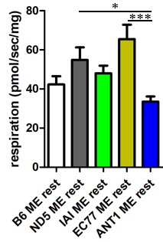
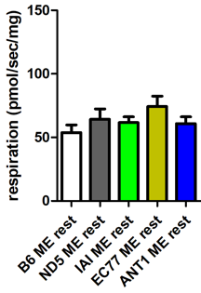
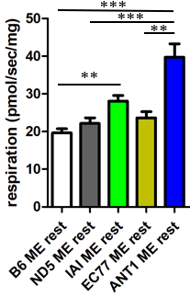
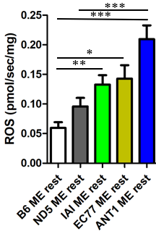
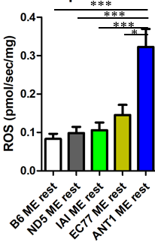
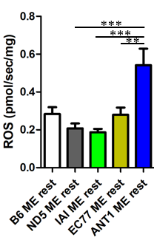
Limiting factors for VO2
O2 consumption – skeletal muscle
CI-capacity
OxPhos capacity
Leak respiration
24 weeks, male, n= 9-15

Slide 9
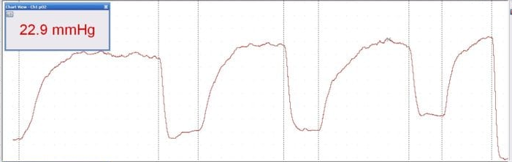
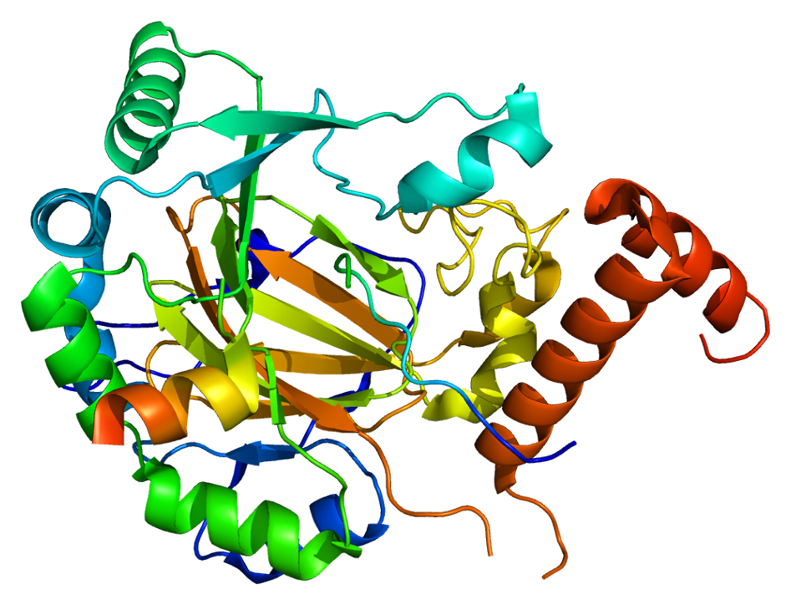
Cold exposure raises VO2 higher than exercise in ANT1 mice
**
***
***
*
***
N=7-9 mice, male, 24 weeks
→ Hypothesis: Skeletal muscle oxygen consumption limits VO2 upon running as opposed to oxygen delivery
vpO2
Muscle pO2
HIF1
Muscle pO2
https://www.scintica.com/products/oxford-optronix/oxygen-monitors/
Mouse under anesthesia
O2 delivery down
→ Time resolution too low

Slide 10
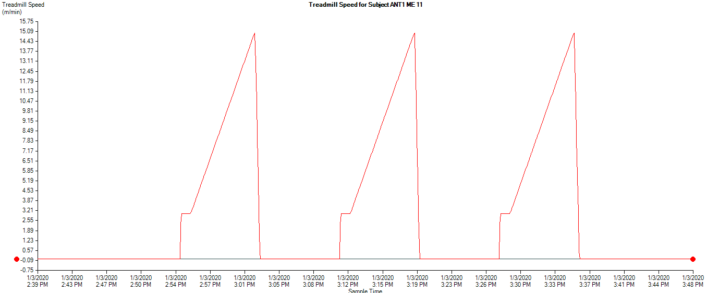
IN ANT1 ME VO2 decrease upon exercise is due to ROS impairing Fe-S clusters
VO2 recovers quickly post running
but: might be non-muscle O2 consumption
Planned:
Oroboros measurements immediately post-exercise
Aconitase activity immediately post-exercise

Slide 11
Summary – Exercise Physiology of mitochondrial mutant mice
- All mitochondrial mutant mice show significantly lower activity level
- Running performance: ND5 > wt > ND6 > COI > ANT1
- VO2 drops upon running in ANT1 ME probably due a decrease in muscle respiration because of ROS impairing FE-S clusters
Endurance exercise response in mitochondrial mutant mice

Slide 12
Longterm exercise did not alter basic physiology significantly
Weight change norm. to rest

Slide 13
Endurance exercise has no effect in ND5 mutant mice
rest
*
*
exercised
*
**
**
##
###
##
###
###
*
*
#
#
*
##
*
#
##
N=18-22

Slide 14
Endurance exercise aggravated dilated cardiomyopathy in ANT1 mice
*
***
*
*
***
***
*
***
***
#
##
*
**
#

Slide 15
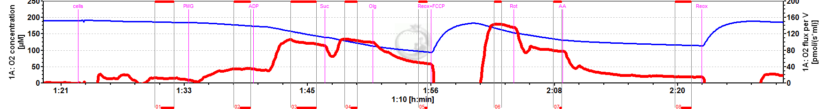
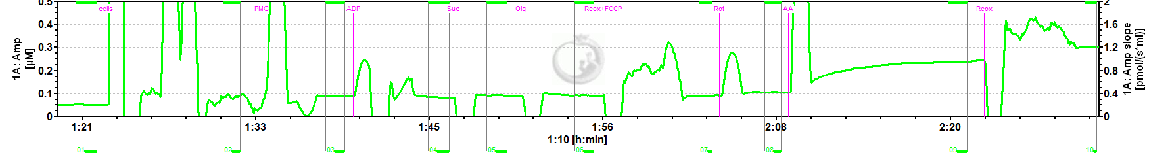
Endurance exercise does not change mitochondrial respiration
*
***
**
**
**
**
**
**

Slide 16
Endurance exercise reduces ROS production in skeletal muscle
*
***
***
***
***
***
***
***
***
***
***
**
***
***
***
***
***
***
***
***
***
***
***
***
***
#
#
***
***
***
***
***
***
**
***
***
***
***
***
***
***
***
***
*
*
*

Slide 17
Summary – Exercise response in mitochondrial mutant mice
Upon endurance exercise
VO2max
running
activity
LV-function
Mt-respiration
ROS
B6 ME
ND5 ME
IAI ME
EC77 ME
ANT1 ME
VO2max
-
+
=
+
=
running
-

Slide 18
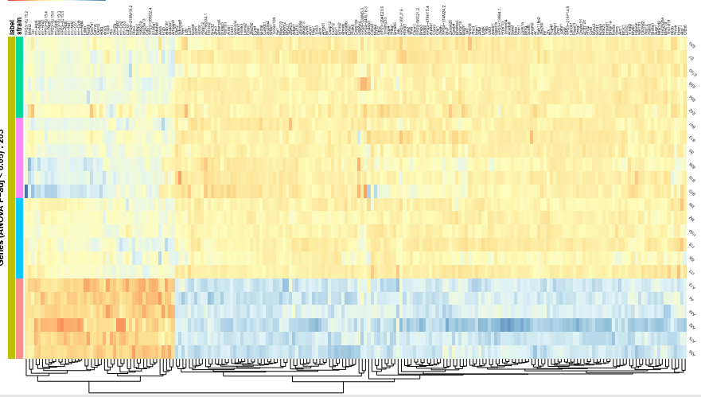
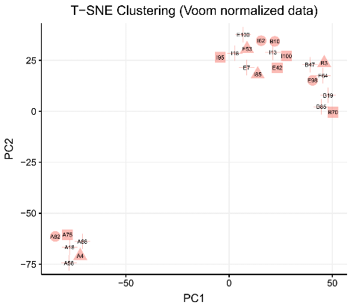
Which pathways mediate differential exercise response in mitochondrial mutant mice?
RNA-Seq of M. soleus
- Exercised (6 mice) and non-exercised (6 mice) from each strain
- Exercised subdivided into 3 responders and 3 non-responders (according to treadmill performance)
ANT1 mice show biggest difference in expression profile
EC77 ME
ND5 ME
IAI ME
ANT1 ME

Slide 19
Metabolic/mitochondrial pathways are differentially regulated
# | Processes | Total | pValue | Min FDR | p-value | FDR | In Data
1 | generation of precursor metabolites and energy | 588 |  |  | 3.941E-14 | 1.853E-10 | 29
2 | electron transport chain | 230 |  |  | 1.632E-13 | 3.835E-10 | 19
3 | oxidation-reduction process | 1284 |  |  | 4.088E-10 | 5.830E-07 | 36
4 | response to abiotic stimulus | 2051 |  |  | 4.961E-10 | 5.830E-07 | 47
5 | cellular metabolic process | 9716 |  |  | 1.805E-09 | 1.581E-06 | 127
6 | phosphorylation | 1705 |  |  | 2.017E-09 | 1.581E-06 | 41
7 | ATP metabolic process | 275 |  |  | 2.556E-09 | 1.630E-06 | 16
8 | respiratory electron transport chain | 137 |  |  | 2.774E-09 | 1.630E-06 | 12
9 | mitochondrial ATP synthesis coupled electron transport | 111 |  |  | 3.483E-09 | 1.802E-06 | 11
10 | ATP synthesis coupled electron transport | 112 |  |  | 3.833E-09 | 1.802E-06 | 11
Pairwise differential gene expression between strains
Number of significant genes (adj. p-value)
Distance normalized
 | ANT1.ME | ND5 ME | EC77.ME
ANT1 ME | 0
ND5 ME | 977 | 0
EC77 ME | 491 | 0 | 0
IAI ME | 395 | 250 | 0
 | ANT1.ME | ND5 ME | EC77.ME
ANT1 ME | 0
ND5 ME | 1 | 0
EC77 ME | 0.780411 | 0.244561 | 0
IAI ME | 0.659561 | 0.366472 | 0.130163

Slide 20
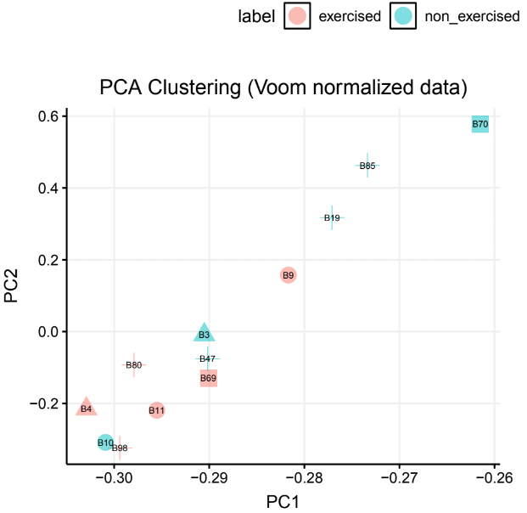
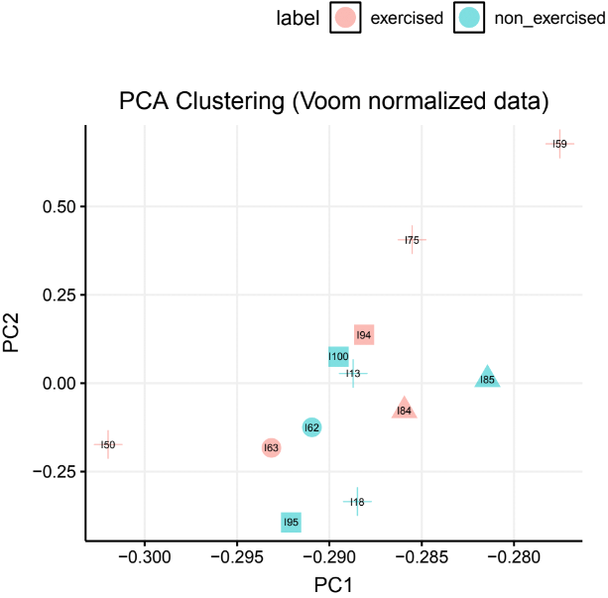
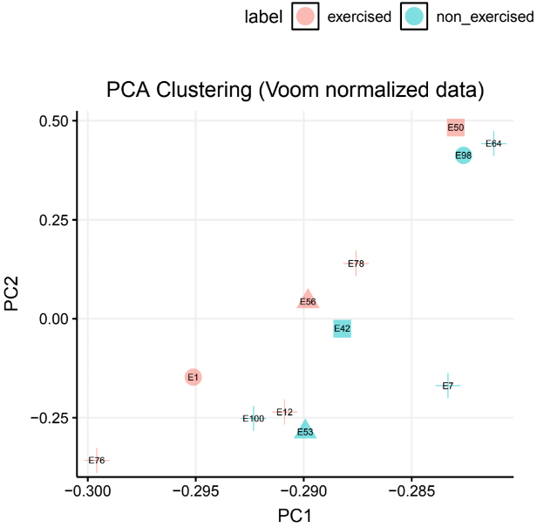
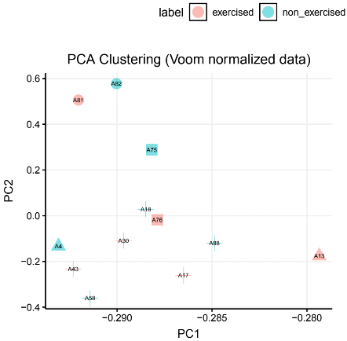
Pairwise differential gene expression between exercised - rested
Number of significant genes (adj. p-value)
Smallest adj. p-value
 | ND5 ME | IAI ME | EC77 ME | ANT1 ME
exercise - rested | 0 | 0 | 0 | 0
resp. - non-resp. | 0 | 0 | 0 | 0
 | ND5 ME | IAI ME | EC77 ME | ANT1 ME
exercise - rested | 0.5568 | 0.2123 | 0.849 | 0.9998
resp. - non-resp. | 0.5565 | 0.9999 | 0.8203 | 0.681
ND5 ME
IAI ME
EC77 ME
ANT1 ME
→ Longterm exercise does not change transcriptional profile in M. soleus?

Slide 21
Which pathways mediate differential exercise response in mitochondrial mutant mice?
Further analysis:
Gene Set Enrichment Analysis (pathway analysis that takes cumulative evidence from all genes)
Correlation of gene expression with covariables (VO2max, running time, RER) across and within strains
Compare distances/pathways between strains for rested and exercised
Planned:
RNASeq for B6 ME (will be sent next week)
RNASeq for hearts of exercised vs rested (raw data back)
RNASeq/metabolomics for skeletal muscle (M. soleus) after acute exercise (1h)?

Slide 22
Thank you for your attention
0m/min
Whew, done for today!

